Slide 1


CMPE 135: Object-Oriented Analysis and Design October 5 Class Meeting
Department of Computer Engineering San Jose State University Fall 2017 Instructor: Ron Mak
www.cs.sjsu.edu/~mak

Slide 2
Point-Circle-Rectangle
class Point
{
public:
Point(int x, int y) : x(x), y(y) {}
virtual ~Point() {}
int get_x() const { return x; }
int get_y() const { return y; }
void move(int dx, int dy) { x += dx; y += dy; }
private:
int x, y;
};
Is there anything
wrong with this
code?
class Circle : public Point
{
public:
Circle(Point center, int radius)
: Point(center.get_x(), center.get_y()),
radius(radius)
{}
private:
int radius;
};
A Circle has a center Point.
But a Circle is not a Point.

Slide 3
Point-Circle-Rectangle, cont’d
Even worse!
The upper-left corner is kept in the superclass.
The lower-right corner is a member variable.
class Rectangle : public Point
{
public:
Rectangle(Point upper_left, Point lower_right)
: Point(upper_left.get_x(), upper_left.get_y()),
lower_right(lower_right)
{}
void move(int dx, int dy) // override Point::move()
{
Point::move(dx, dy);
lower_right.move(dx, dy);
}
private:
Point lower_right;
};
A Rectangle
has two Points.
But a Rectangle
is not a Point.

Slide 4
Vector-Stack
#include <string>
#include <vector>
using namespace std;
template<typename T>
class Stack : public vector<T>
{
public:
Stack();
void push(T item);
T pop();
};
template<typename T>
void Stack<T>::push(T item)
{
stack.push_back(item);
}
template<typename T>
T Stack<T>::pop()
{
T top_item = stack.at(stack.size() - 1);
stack.pop_back();
return top_item;
}
int main()
{
Stack<string> stk;
stk.push("A");
stk.push("B");
stk.push("C");
stk.erase(stk.begin() + 1); // remove "B"
}
What is wrong
with this code?
A stack is not a vector.

Slide 5
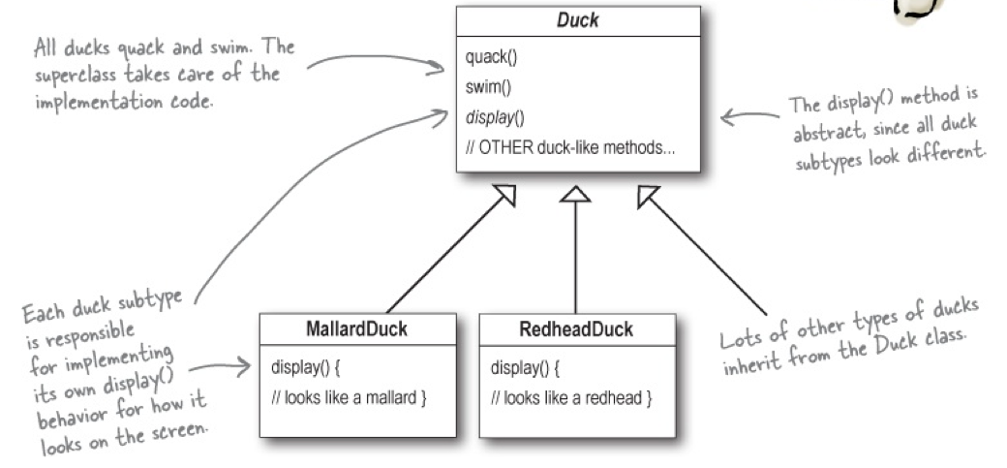
SimUDuck Simulation Game
Use object-oriented design techniques to create a duck simulation game.
Head First Design Patterns
by Eric & Elisabeth Freeman
O’Reilly, 2004

Slide 6
SimUDuck Simulation Game, cont’d
We need to make the ducks fly.
Head First Design Patterns
by Eric & Elisabeth Freeman
O’Reilly, 2004

Slide 7
Something Went Wrong
Head First Design Patterns
by Eric & Elisabeth Freeman
O’Reilly, 2004

Slide 8
Joe Thinks about Inheritance
Head First Design Patterns
by Eric & Elisabeth Freeman
O’Reilly, 2004

Slide 9
What about Interfaces?
Head First Design Patterns
by Eric & Elisabeth Freeman
O’Reilly, 2004

Slide 10
What about Interfaces? cont’d
Head First Design Patterns
by Eric & Elisabeth Freeman
O’Reilly, 2004

Slide 11
What about Interfaces? cont’d
Head First Design Patterns
by Eric & Elisabeth Freeman
O’Reilly, 2004

Slide 12
Encapsulate What Varies
Head First Design Patterns
by Eric & Elisabeth Freeman
O’Reilly, 2004

Slide 13
Design the Duck Behaviors
Head First Design Patterns
by Eric & Elisabeth Freeman
O’Reilly, 2004

Slide 14
Program to an Interface
Suppose abstract class Animal has two concrete implementations, Dog and Cat.
Program to an implementation:
Program to an interface:
“Program to an interface” really means “Program to a superclass”.
Dog *d = new Dog();
d->bark();
Animal *animal = new Dog();
animal->make_sound();
Head First Design Patterns
by Eric & Elisabeth Freeman
O’Reilly, 2004

Slide 15
Implement the Duck Behaviors
Head First Design Patterns
by Eric & Elisabeth Freeman
O’Reilly, 2004

Slide 16
Code Reuse
With this design, other types of objects can reuse our fly and quack behaviors because these behaviors are no longer hidden away in our Duck classes.
We can add new behaviors without modifying any of our existing behavior classes or touching any of the Duck classes that use flying behaviors.
So we get the benefit of reuse without all the baggage that comes along with inheritance.

Slide 17
Delegate Duck Behaviors
A Duck can delegate its flying and quacking behavior, instead of using quacking and flying member functions defined in the Duck class or subclasses.

Slide 18
Delegate Duck Behaviors, cont’d
Head First Design Patterns
by Eric & Elisabeth Freeman
O’Reilly, 2004

Slide 19
Delegate Duck Behaviors, cont’d
QuackBehavior.h
class QuackBehavior
{
public:
virtual ~QuackBehavior() {}
virtual void quack() = 0;
};
FlyBehavior.h
class FlyBehavior
{
public:
virtual ~FlyBehavior() {}
virtual void fly() = 0;
};

Slide 20
The Abstract Duck Superclass
Duck.h
Duck.cpp
#include "QuackBehavior.h"
#include "FlyBehavior.h"
class Duck
{
public:
virtual ~Duck() {}
void perform_quack();
void perform_fly();
virtual void identify() = 0;
protected:
QuackBehavior *quack_behavior;
FlyBehavior *fly_behavior;
};
#include "Duck.h"
#include "QuackBehavior.h"
#include "FlyBehavior.h"
void Duck::perform_quack()
{
quack_behavior->quack();
}
void Duck::perform_fly()
{
fly_behavior->fly();
}
Quacking is delegated to
the quack_behavior object.
Flying is delegated to
the fly_behavior object.

Slide 21
Implement Quack Behaviors
Quack.h
Quack.cpp
#include "QuackBehavior.h"
class Quack : public QuackBehavior
{
public:
void quack();
};
class Squeak : public QuackBehavior
{
public:
void quack();
};
class Mute : public QuackBehavior
{
public:
void quack();
};
#include <iostream>
#include "Quack.h"
using namespace std;
void Quack::quack()
{
cout << " Quack!" << endl;
}
void Squeak::quack()
{
cout << " Squeak!" << endl;
}
void Mute::quack() {}

Slide 22
Implement Fly Behaviors
Fly.h
Fly.cpp
#include "FlyBehavior.h"
class Fly : public FlyBehavior
{
public:
void fly();
};
class NoFly : public FlyBehavior
{
public:
void fly();
};
#include <iostream>
#include "Fly.h"
using namespace std;
void Fly::fly()
{
cout << " I can fly!" << endl;
}
void NoFly::fly()
{
cout << " I can't fly!" << endl;
}

Slide 23
Create Mallard and Rubber Ducks
DuckTypes.h
DuckTypes.cpp
#include "Duck.h"
class MallardDuck : public Duck
{
public:
MallardDuck();
void identify();
};
class RubberDuck : public Duck
{
public:
RubberDuck();
void identify();
};
#include ...
using namespace std;
MallardDuck::MallardDuck()
{
quack_behavior = new Quack();
fly_behavior = new Fly();
}
void MallardDuck::identify()
{
cout << "Mallard duck" << endl;
}
RubberDuck::RubberDuck()
{
quack_behavior = new Squeak();
fly_behavior = new NoFly();
}
void RubberDuck::identify()
{
cout << "Rubber duck" << endl;
}

Slide 24
Test Ducks
DuckTest.cpp
#include <iostream>
#include "DuckTypes.h"
using namespace std;
int main()
{
MallardDuck *mallard = new MallardDuck();
RubberDuck *rubber = new RubberDuck();
mallard->identify();
mallard->perform_quack();
mallard->perform_fly();
cout << endl;
rubber->identify();
rubber->perform_quack();
rubber->perform_fly();
return 0;
}
Set behavior
at run time.

Slide 25
The Big Picture on Encapsulated Behaviors
Head First Design Patterns
by Eric & Elisabeth Freeman
O’Reilly, 2004

Slide 26
“Has a” is Better Than “Is a”
Design principle:
Composition is more flexible.
You can set and change behavior at run time.
Favor composition over inheritance.

Slide 27
Point-Circle-Rectangle Revisited
class Point
{
public:
Point(int x, int y) : x(x), y(y) {}
virtual ~Point() {}
int get_x() const { return x; }
int get_y() const { return y; }
void move(int dx, int dy) { x += dx; y += dy; }
private:
int x, y;
};
class Circle
{
public:
Circle(Point center, int radius)
: center(center), radius(radius)
{}
private:
Point center; // composition
int radius;
};
A Circle has a center Point.

Slide 28
Point-Circle-Rectangle, cont’d
class Rectangle
{
public:
Rectangle(Point upper_left, Point lower_right)
: upper_left(upper_left), lower_right(lower_right)
{}
void move(int dx, int dy) // override Point::move()
{
upper_left.move(dx, dy);
lower_right.move(dx, dy);
}
private:
Point upper_left; // composition
Point lower_right;
};
A Rectangle
has two Points.

Slide 29
Vector-Stack
#include <string>
#include <vector>
using namespace std;
template<typename T>
class Stack
{
public:
Stack();
void push(T item);
T pop();
private:
vector<T> stack;
};
template<typename T>
void Stack<T>::push(T item)
{
stack.push_back(item);
}
template<typename T>
T Stack<T>::pop()
{
T top_item = stack.at(stack.size() - 1);
stack.pop_back();
return top_item;
}
int main()
{
Stack<string> stk;
stk.push("A");
stk.push("B");
stk.push("C");
//stk.erase(stk.begin() + 1); // not allowed
}
A stack is not a vector.

